Slide 1


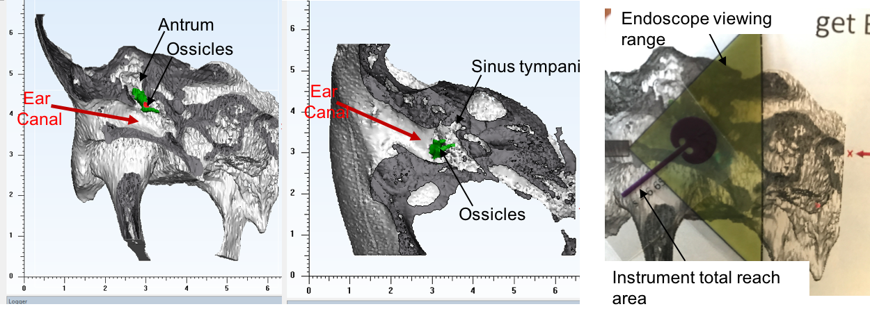
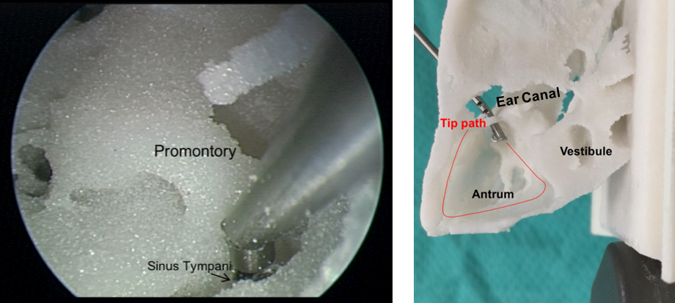
Design of Controllable Flexible Instruments to Facilitate Endoscopic Ear Surgery
Arushri Swarup^{1,2,3}, Adrian L. James³
¹Department of Otolaryngology – Head and Neck Surgery, Faculty of Medicine, University of Toronto, Toronto, ON, Canada
²Centre for Image Guided Innovation and Therapeutic Intervention, The Hospital for Sick Children, Toronto, ON, Canada
³Institute of Biomaterials and Biomedical Engineering, University of Toronto, Toronto, ON, Canada
arushri.swarup@mail.utoronto.ca
REB #s: 1000033566, 100005/5626
Transcanal endoscopic ear surgery (TEES) is a new minimally invasive middle ear surgery technique to access otherwise hidden recesses within the middle ear¹⁻⁴. While TEES reduces length of hospital stay and patient morbidity, the surgical technique is challenging since only one hand can handle an instrument which must pass through the narrow ear canal^{5,6}. Presently, surgeons performing TEES use otologic instruments developed for two-handed surgery which are not optimized for the TEES environment.
Objective: Design instruments to facilitate the challenges experienced during transcanal endoscopic ear surgery (TEES).
Defining the Challenges of TEES
Development of a New Instrument for TEES
As TEES is a young field, a needs analysis study was conducted to define the primary challenges faced by surgeons.
To address the challenges of TEES, an instrument was designed, prototyped and tested to reach the structures visualized by the endoscope.
Needs Analysis Study
Reaching Solution: Incorporate a flexible “wrist” at the tip of the instrument.
By cutting notches into a tube made of nitinol (a superelastic metal), the tube can bend by pulling on an attached cable. A specific notch geometry is selected to achieve the desired bending shape while increasing stiffness⁷.
Instrument Tip Design
Study Results
Patient CT scans informed the design of the tip in order to reach the target anatomy, including the antrum and sinus tympani where cholesteatoma is usually found and currently inaccessible without removing bone. The desirable bending angle is 135º which allows the tip to reach the boundary of the endoscope viewing angle.
Reaching structures visualized by the endoscope yielded the greatest need for better instruments.
Survey comments called for new instruments to improve reach, dissect and remove cholesteatoma, bone removal, and control bleeding.
Instrument Prototype
The tip was manufactured by laser cutting a nitinol tube and attached to a handle which could articulate the joint. The handle is designed to maintain a similar grip used for existing ear surgery instruments with the addition of a finger piece for controlling the tip.
Instrument Testing
Reaching Problem: current instruments cannot reach all structures visualized by the endoscope without the removal of bone.
The instrument was tested using an endoscope inside 3D printed patient temporal bone models generated from the CT scans. It was possible to reach the sinus tympani and antrum.
Future Work
Future work involves further testing of the tip to ensure it can safely encounter the tissue forces experienced during surgery, orient a laser fibre safely and effectively, and reach the desired targets within the middle ear without significant bone removal and ultimately facilitate endoscopic ear surgery.
References
1. Cohen MS, Landegger LD, Kozin ED, Lee DJ. Pediatric endoscopic ear surgery in clinical practice: Lessons learned and early outcomes. Laryngoscope. 2015:732-738. 2. Kanona H, Virk JS, Owa A. Endoscopic ear surgery: A case series and first United Kingdom experience. World J Clin cases. 2015;3(3):310-317. 3. Badr-el-dine M. Instrumentation and Technologies in Endoscopic Ear Surgery. Otolaryngol Clin NA. 2013;46(2):211-225. 4. Bennett ML, Zhang D, Labadie RF, Noble JH. Comparison of Middle Ear Visualization With Endoscopy and Microscopy. Otol Neurotol. 2016;37:362-366. 5. Yong M, Mijovic T, Lea J. Endoscopic ear surgery in Canada : a cross-sectional study. J Otolaryngol - Head Neck Surg. 2016:1-8. 6. Mijovic T, Lea J. Training and Education in Endoscopic Ear Surgery. Curr Otorhinolaryngol Rep. 2015;3(4):193-199. 8. Eastwood KW, Francis P, Azimian H, Swarup A, Looi T, Drake JM, Naguib HE. Design of a Contact-Aided Compliant Notched-Tube Joint for Surgical Manipulation in Confined Workspaces. ASME. J. Mechanisms Robotics. 2017;():. [accepted manuscript]
Notes:
Since we’re submitting the needs analysis to otology and neurotology, how much of the results should we present here? Sentac won’t publish the poster, so this stuff won’t be published, which is what I’ve agreed upon in the submission
Label ear canal and instrument for reacing problem
Bring along an instrument

